Slide 1

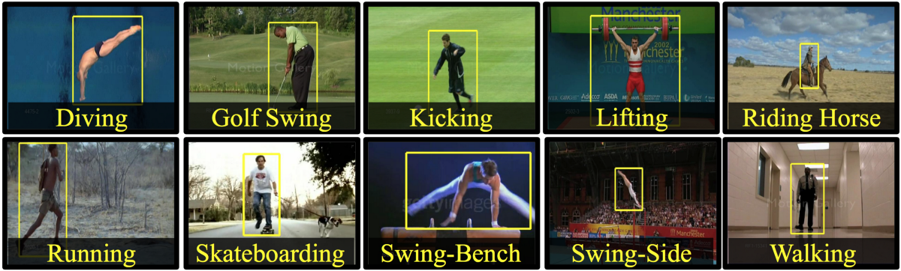
Vishwakarma Institute of Technology, Pune
EDI
Human Action Recognition
Presented By:
Swapnil patil(59)
Komal Shinde(69)
Devyani Ushir(75)
Aditya Vhanmane(76)
Guided By: prof. S. B. Bhorge

Slide 2
Introduction
Literature Survey
Research Gap
Novelty
Methodology
Results
Advantages and Limitations
Conclusion
Contents

Slide 3
PROBLEM STATEMENT
To identify and detect simple and complex activities in real-world situations using deep learning .
Developing a deep learning model that can accurately classify and recognize human actions in videos using a large video dataset.
Notes:
developing a deep learning model that can accurately classify and recognize human actions in videos using a large video dataset. The challenge is to create a model that can handle the sequential nature of human actions, while also being able to capture the spatial and temporal features of the video data. The goal is to create a robust and accurate system that can be used for a variety of applications, such as video surveillance, human-robot interaction, and sports analysis. The effectiveness of the model will be evaluated based on its accuracy in recognizing human actions from a test dataset that contains videos of previously unseen human actions.

Slide 4
OBJECTIVES
The main aim of human activities Recognition system is to identify all the object, persons and the actions performed by them in the given video.
To develop an automated system for the same.
Notes:
To develop an accurate and efficient deep learning model for human action recognition using LSTM and CNN architectures.
To preprocess and prepare a large video dataset that contains a diverse range of human actions, captured from various viewpoints and in different environments.
To design a network architecture that can capture the spatial and temporal features of the video data and handle the sequential nature of human actions.
To train the deep learning model on the prepared video dataset to learn the relevant features and classify the human actions accurately.
To evaluate the effectiveness of the developed model on a test dataset that contains videos of previously unseen human actions and compare its performance with existing state-of-the-art models.

Slide 5
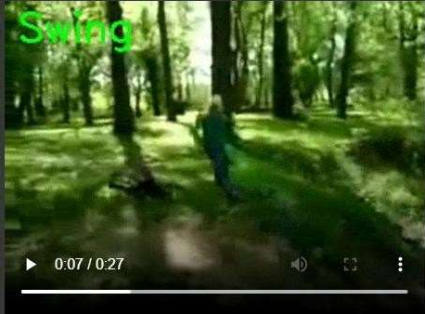
INTRODUCTION
Human activities Recognition is an important area of computer vision research and application.
The goal of the activity recognition is an automated analysis or interpretation of ongoing events and their context from video data.
Notes:
Human action recognition is an important research area in computer vision and deep learning, with numerous practical applications in fields such as surveillance, human-robot interaction, sports analysis, and healthcare. The ability to accurately classify and recognize human actions in videos can provide valuable insights into human behavior and can be used for various decision-making tasks, such as anomaly detection, event recognition, and activity forecasting.
In recent years, deep learning techniques, particularly LSTM (Long Short-Term Memory) and CNN (Convolutional Neural Network) architectures, have shown promising results in human action recognition from video datasets. These techniques can capture the spatial and temporal features of the video data and handle the sequential nature of human actions, making them well-suited for this task.
In this project, we aim to develop a deep learning model using LSTM and CNN architectures for human action recognition from videos. We will preprocess and prepare a large video dataset that contains a diverse range of human actions, captured from various viewpoints and in different environments. We will design a network architecture that can capture the relevant features of the video data and classify the human actions accurately. We will train and evaluate the developed model on the prepared video dataset and compare its performance with existing state-of-the-art models. Finally, we will explore the potential applications of the developed model in real-world scenarios and contribute to the field of computer vision and deep learning for human action recognition.

Slide 6
LITERATURE SURVEY

Slide 7
Recognizing 50 Human Action Categories of Web Video
[1]
The proposed approach has the best performance on datasets like UCF11 (87.19%), UCF50 (76.90%) and HMDB51 (27.02%).
They showed that, as the number of categories increases, the motion descriptors become less discriminative.
3D Convolution Neural Networks for Human Action Recognition
[2]
These models develop features from both spatial and temporal measurements by performing 3D convolutions.
To perform convolution and sub sampling separately in each channel it has to develop a deep architecture that generates multiple channels of information from adjacent input frames.
Human Action Recognition via Skeletal and Depth based Feature Fusion
[3]
A successful way to deal with this unpredictability is to isolate the human body into various body parts as indicated by human skeletal joint positions, and perform acknowledgment dependent on these part-based element descriptors.

Slide 8
STAP: Spatial-Temporal Attention-Aware Pooling for Action Recognition
[4]
proposes system evaluated on three popular video action data sets Namely, 95.3% on UCF Sports (better by 4.0%), 87.9% on YouTube data set (better by 2.5%), and comparable results on Hollywood2 data set.
A Robust Human Action Recognition System using Single Camera
[5]
The system can remove shadows and extract a contour correctly in different environments. Although the system has a high recognition rate, there are still some restrictions in this system.
Vision-based human action recognition attempts to give a simple, direct and natural way to achieve this goal.
View Invariant Human Action Recognition Using Histograms of 3D Joints
[6]
present a novel approach for human action recognition with histograms of 3D joint locations. Our method is real-time and achieves superior results on the challenging 3D action dataset. We also tested our algorithm on the MSR Action3D dataset and it outperformed Li et al. on most of the cases.

Slide 9
Action Recognition Using HOG Feature in Different Resolution Video Sequences [4] This paper developed a action recognition using HOG feature in video sequences of different resolutions based on Hierarchical Filtered Motion model and Nearest Neighbor classifier. some key technologies are used in this framework like interest point detection in Motion History Image (MHI), Hierarchical Filtered Motion Model
Action Detection and Recognition in Continuous Action Streams by Deep Learning-Based Sensing Fusion
[5]
The developed system is examined for two applications: one involving. Transition movements for home healthcare monitoring and the other involving smart TV hand gestures.
Decision-level fusion applied to the actions of interest that are detected by both modalities.

Slide 10
Single Frame Classification
Late Fusion Approach
Research Gap
Early Fusion Approach
Using Pose Detection and LSTM
CNN+LSTM
Notes:
Single-Frame Classification
The simplest and most basic way of classifying actions in a video can be using an image classifier on each frame of the video and classify action in each frame independently. The classifier predicts Falling in some frames instead of Backflipping because this approach ignores the temporal relation of the frames sequence. And even if a person looks at those frames independently he may think that the person is Falling.
Late Fusion
Another slightly different approach is late fusion, in which after performing predictions on each frame independently, the classification results are passed to a fusion layer that merges all the information and makes the prediction. This approach also leverages the temporal information of the data.
Convolutional Neural Network (CNN)
A Convolutional Neural Network (CNN or ConvNet) is a type of deep neural network that is specifically designed to work with image data and excels when it comes to analyzing the images and making predictions on them.
Early Fusion
Another approach of video classification is early fusion, in which all the information is merged at the beginning of the network, unlike late fusion which merges the information in the end. This is a powerful approach but still has its own limitations.
Using Pose Detection and LSTM
Another method is to use a pose detection network on the video to get the landmark coordinates of the person for each frame in the video. And then feed the landmarks to an LSTM Network to predict the activity of the person.
CNN + LSTM
We will be using a CNN to extract spatial features at a given time step in the input sequence (video) and then an LSTM to identify temporal relations between frames. The two architectures that we will be using to use CNN along with LSTM are:
ConvLSTM
LRCN

Slide 11
Real
Accurate Reorganization of human actions
Novelty
Compilation of custom dataset
Lightweight system with good accuracy
Well And Fine Accuracy

Slide 12
METHODOLOGY

Slide 13
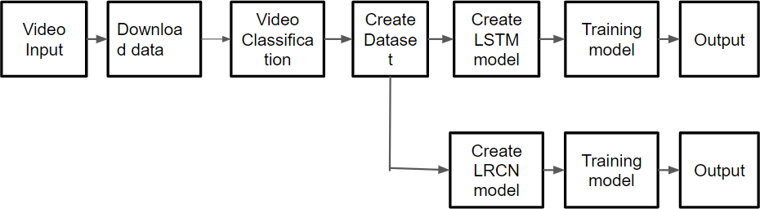
System Block Diagram

Slide 14
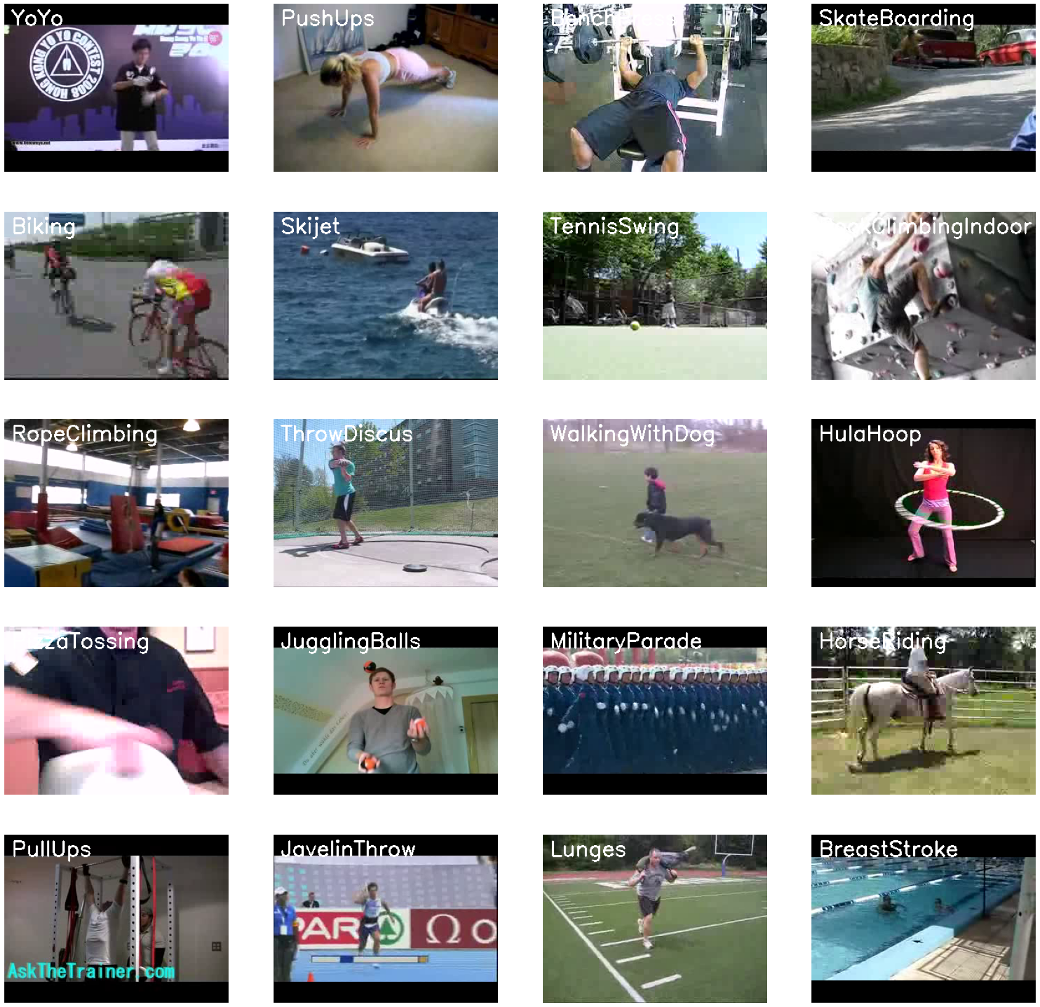
Dataset Collection
Clarity Dataset Creation
UCF50 Dataset, 50 Actions
Extension of YouTube dataset, 11 Action Categories
Provide the computer vision community
For all the 50 categories, the videos are grouped into 25 groups per Action Categories
Fig.1. Dataset Creation

Slide 15
Accuracy
A = 𝑇𝑃 + 𝑇𝑁 / 𝑇𝑃 +𝑇𝑁 +𝐹𝑃 +𝐹𝑁
Recall
R = 𝑇𝑃 / 𝑇𝑃 + 𝐹𝑁
Precision
P = 𝑇𝑃 / 𝑇𝑃 + 𝐹P
F- Score
Performance Metrics
Classification and Analysis:

Slide 16
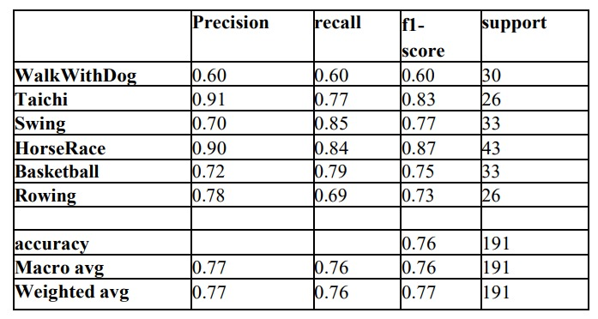
Performance Evaluation I LSTM
Performance Metrics
Classification
Accuracy

Slide 17
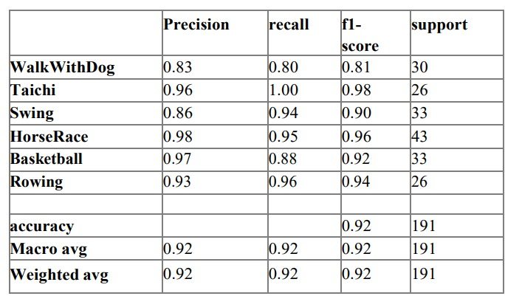
Performance Evaluation II LRCN
Performance Metrics
Performance
Accuracy

Slide 18
Advantages
Limitations
Calculate a predictive model that can recognize a person ‘s activity.
Discover Activity patterns
Cost effective
Analyze the activity of a person from the information collection by different devices
Not take Multiple Actions
Limited dataset

Slide 19
Human Activity Recognition is quite useful and effective for solving a variety of application ,Whether it would be surveillance , monitoring , or aiding the elderly and blind people etc.
This not only provide additional comfort to the end-users but also can be deployed into different organization in order to reduce the employee workload.
Conclusion
Notes:
Need of Activity recognition for monitoring and surveillance , video segmentation etc is of growing demand in which this system can greatly help.

Slide 20
References:
[1]. Reddy, K. K., & Shah, M. (2013). Recognizing 50 human action categories of web videos. Machine vision and applications, 24(5), 971-981.
[2]. Ji, S., Xu, W., Yang, M., & Yu, K. (2012). 3D convolutional neural networks for human action recognition. IEEE transactions on pattern analysis and machine intelligence, 35(1), 221-231.
[3]. Li, M., Leung, H., & Shum, H. P. (2016, October). Human action recognition via skeletal and depth based feature fusion. In Proceedings of the 9th International Conference on Motion in Games (pp. 123-132).
[4]. Nguyen, T. V., Song, Z., & Yan, S. (2014). STAP: Spatial-temporal attention-aware pooling for action recognition. IEEE Transactions on Circuits and Systems for Video Technology, 25(1), 77-86.
[5]. Yuan, X., & Yang, X. (2009, December). A robust human action recognition system using single camera. In 2009 International Conference on Computational Intelligence and Software Engineering (pp. 1-4). IEEE.
[6]. Cao, L., Tian, Y., Liu, Z., Yao, B., Zhang, Z., & Huang, T. S. (2010, July). Action detection using multiple spatial-temporal interest point features. In 2010 IEEE International Conference on Multimedia and Expo (pp. 340-345). IEEE.

Slide 21
[7]. Xia, L., Chen, C. C., & Aggarwal, J. K. (2012, June). View invariant human action recognition using histograms of 3d joints. In 2012 IEEE computer society conference on computer vision and pattern recognition workshops (pp. 20-27). IEEE.
[8]. Huang, Y., Yang, H., & Huang, P. (2012, March). Action recognition using hog feature in different resolution video sequences. In 2012 International Conference on Computer Distributed Control and Intelligent Environmental Monitoring (pp. 85-88). IEEE.
[9]. Dawar, N., & Kehtarnavaz, N. (2018). Action detection and recognition in continuous action streams by deep learning-based sensing fusion. IEEE Sensors Journal, 18(23), 9660-9668
[10]. Zhou, Z., Shi, F., & Wu, W. (2015). Learning spatial and temporal extents of human actions for action detection. IEEE Transactions on multimedia, 17(4), 512-525.
[11]. Zarka, N., Alhalah, Z., & Deeb, R. (2008, April). Real-time human motion detection and tracking. In 2008 3rd international conference on information and communication technologies: from theory to applications (pp. 1-6). IEEE.
[12]. Lao, W., Han, J., & De With, P. H. (2009). Automatic video-based human motion analyzer for consumer surveillance system. IEEE Transactions on Consumer Electronics, 55(2), 591-598.

Slide 22
THANK YOU
We would like to extend our sincere gratitude and thank The Reviewers, Organizing Committee Members and Respected Session Chairs for giving us the opportunity to present our Project.

